Slide 1

Matrix Multiplication-Divide and Conquer

Slide 2
Introduction
2 square matrix A,B each size n×n
Need to do multiplication

Slide 3

Basic Matrix Multiplication
Suppose we want to multiply two matrices of size N x N: for example A x B = C.
C₁₁ = a₁₁b₁₁ + a₁₂b₂₁
C₁₂ = a₁₁b₁₂ + a₁₂b₂₂
C₂₁ = a₂₁b₁₁ + a₂₂b₂₁
C₂₂ = a₂₁b₁₂ + a₂₂b₂₂
2x2 matrix multiplication can be accomplished in 8 multiplication.(2^{log}₂⁸ =2³)

Slide 4
Method1

Slide 5
Algorithm: Matrix-Multiplication (A,B,C)
{
for i = 1 to n do
{
for j = 1 to n do
{
C[i,j] := 0
for k = 1 to n do
C[i,j] := C[i,j] + A[i,k] × B[k,j]
}
}
}

Slide 6
Cont….
Since 3 loops here
Time complexity O(n³)

Slide 7
Method 2

Slide 8
Method 2 – simple divide and conquer
Let A &B be 2 n×n matrices
Suppose n is the power of 2
Ie : n=2^k
K - any non-ve integer
If n is not power of 2 ,add enough rows ,columns of zeros to A and B
Imagine A & B each divided into 4 square submatrices
Each of size n/2 × n/2

Slide 9
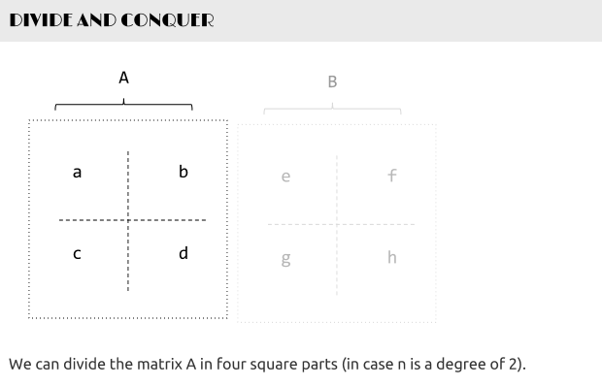

Slide 10
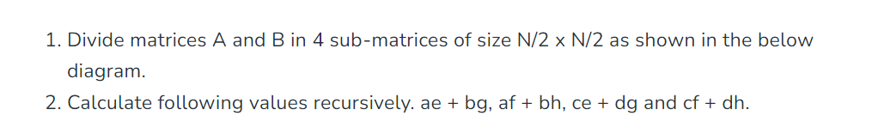
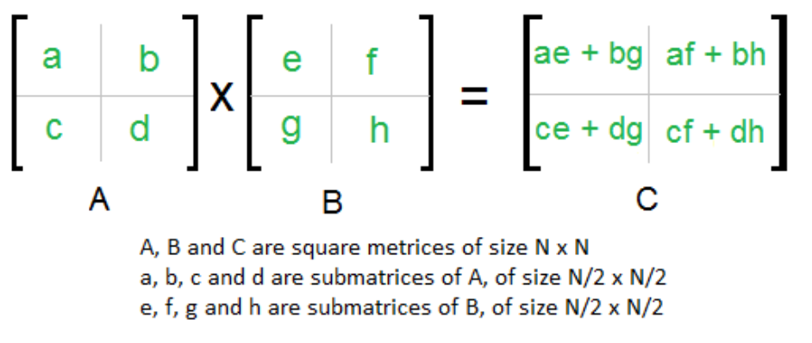

Slide 11
Cont…
Calculate the values recursively
C₁₁ = a₁₁b₁₁ + a₁₂b₂₁
C₁₂ = a₁₁b₁₂ + a₁₂b₂₂
C₂₁ = a₂₁b₁₁ + a₂₂b₂₁
C₂₂ = a₂₁b₁₂ + a₂₂b₂₂
Again – the same complexity – we have 8 products and 4 sums. Where’s the catch?

Slide 12
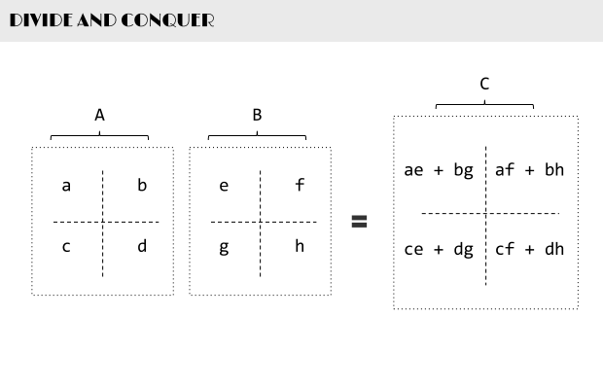

Slide 13

In the above method, we do 8 multiplications for matrices of size N/2 x N/2 and 4 additions.
Addition of two matrices takes O(N²) time. So the time complexity can be written as

Slide 14
Cont…
b n<=2
T(n) = {
8T(n/2) + c (n^2) n>2
b,c constatns
If we solve using masters theorem will get
T(n) = O(n^3)

Slide 15

Method 3- strassens method
Similer to method 2
Apply divide and conquer to divide a matrix of size n to submatrices of size n/2×n/2

Slide 17
Here we calculate P1 to P7
P1= a(f-h)
P2= (a+b)h
P3=(c+d) e
P4= d(g-e)
P5=(a+d)(e+h)
P6=(b-d)(g+h)
P7=(a-c)(e+f)

Slide 18
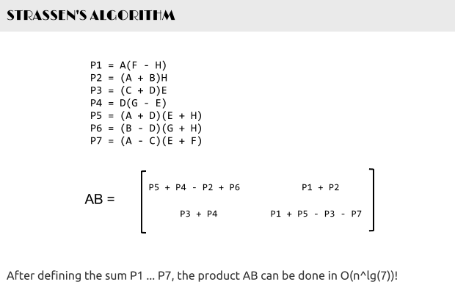

Slide 19
Cont…
Here we recuce the number of multiplication
Total 7 multiplications and 10 additions and subtractions
Addition and subtraction take c(n^2) time

Slide 20
b n<=2
T(n) = {
7T(n/2) + c (n^2) n>2
b,c constatns
= O(n^2.8074)
Less than O(n^3)

